Slide 1
Illustrations © 2021 Tony Ross

Slide 2
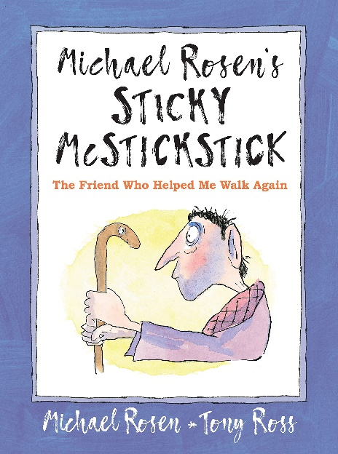
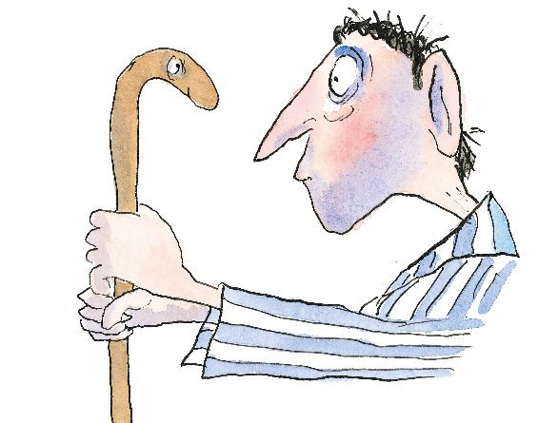
Michael’s Story
In March 2020, poet and author Michael Rosen became very ill with COVID-19.
He was so ill that he was put to sleep for 40 days and 40 nights.
‘Sticky McStickstick’ is Michael’s new book.
It is the story of how Michael’s walking stick (‘Sticky’) became his best friend. Along with the hospital staff, Sticky helped Michael to learn to walk again until, eventually, the day came where he didn’t need it anymore.
Illustrations © 2021 Tony Ross

Slide 3
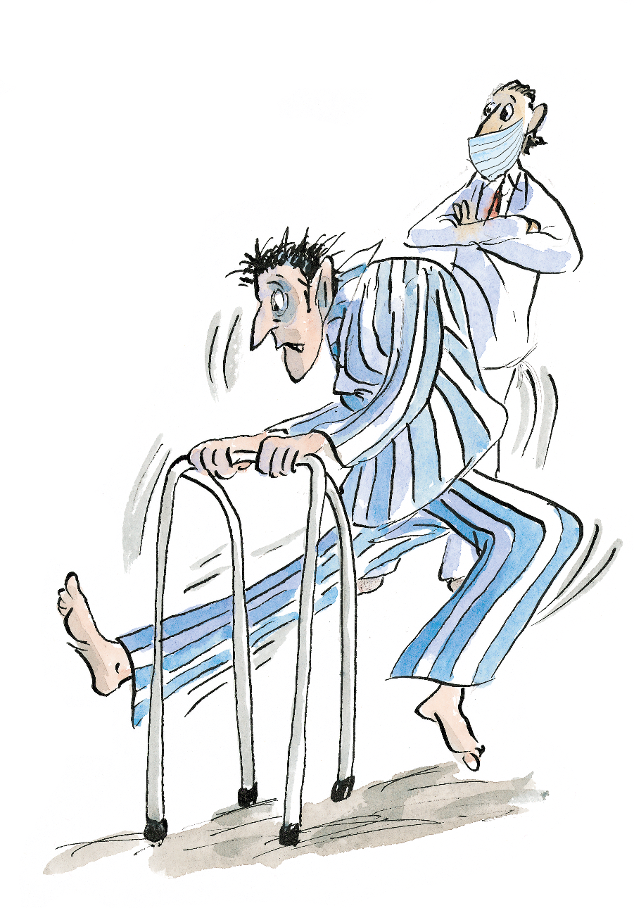
Michael Rosen’s Poetry Competition
Everyone faces a challenge at some point in their lives. Often, writing about our difficult moments can help us to heal and feel better.
Michael would like you to write your own poem about how you overcame a challenge or difficulty. To help you, Michael has made this video where he explains his top tips for writing poetry.
Click here to watch the video.
Illustrations © 2021 Tony Ross

Slide 4
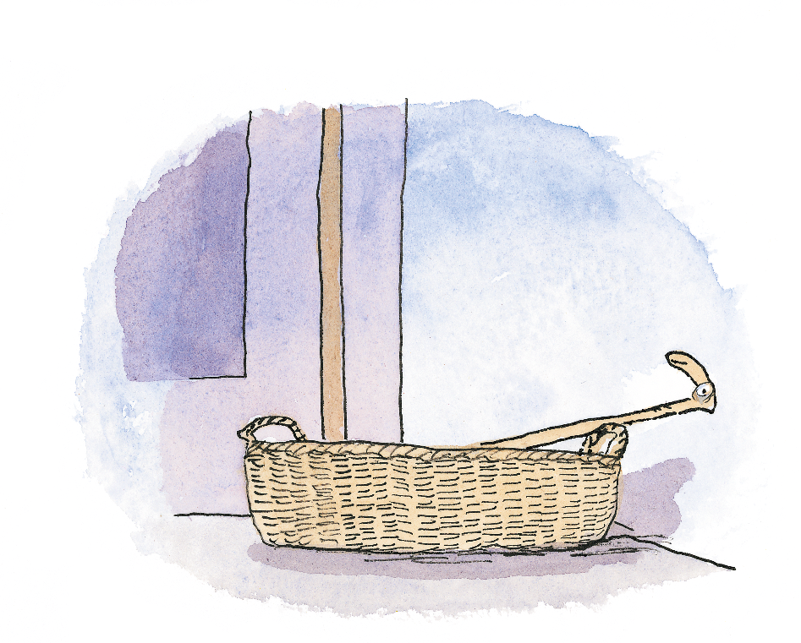
Tip One: Using a Personal Moment
Once you have decided what you are going to write about, try to get back into the moment and live it again.
Decide whose point of view you will write the poem from.
You could write your poem:
in the first person (using ‘I’) or
in the third person, as if you were someone else (using ‘he’, ‘she’, ‘them’ etc.).
Illustrations © 2021 Tony Ross

Slide 5
Tip One: Using a Personal Moment
Then, think about when you want the actions to take place.
You could write your poem:
in the present tense (as if it is happening now) or
in the past tense (as if it had already happened).
present tense
past tense
I am looking
he/she is thinking
they are talking
I was looking
he/she was thinking
they were talking
Illustrations © 2021 Tony Ross

Slide 6
Tip One: Using a Personal Moment
To help you to write your poem, try and ask yourself:
What could I hear?
What was I thinking about?
What could I see in that moment?
Why do I remember
that moment so clearly?
What makes it stick in my mind?
What was I saying? What were others saying?
Illustrations © 2021 Tony Ross

Slide 7
Tip Two: Identifying Sounds
Alliteration is a poetic device that involves repeating the sounds at the beginning of words.
Begin by picking a word that stands out to you. This could be a thing, a feeling or place.
soon
safe
splash
swimming
Now, think of other words that begin with the same sound.
stroke
side
superstar
Try writing a few phrases or sentences using these words.
For example:
I pushed off from the side with a splash and a stroke.
Soon, I felt safe; I was a swimming superstar!

Slide 8
Tip Three: Using Adjectives
Adjectives are words that describe nouns.
They are useful, descriptive tools that help the reader to create vivid images in their mind.
Try picking an object or a thing and then adding a few adjectives to help describe it.
For example:
the colossal, rocky mountain path
my stepdad’s delicious, spicy curry
their quaint, cosy cottage by the sea
Illustrations © 2021 Tony Ross

Slide 9
Tip Three: Looking at Rhyming Patterns
Poems can have different rhyming patterns. We call these rhyming schemes. This is the way that the rhyming words are organised in a poem.
What do you notice about the rhyming scheme of this poem?
In my dreams, I soared way high above
A
We say this poem has an AABB rhyme scheme.
the clouds and whispered to a friendly dove
A
the way to a faraway, magical place.
B
She replied, “Let’s go — we can make it a race!”
B
Other common rhyme schemes include: AAAA, ABAB and XAXA (where only the words at the end of the second and fourth lines rhyme).

Slide 10
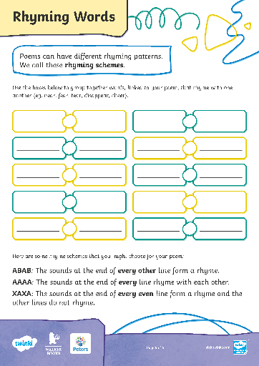
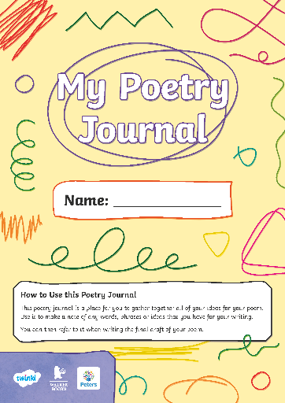
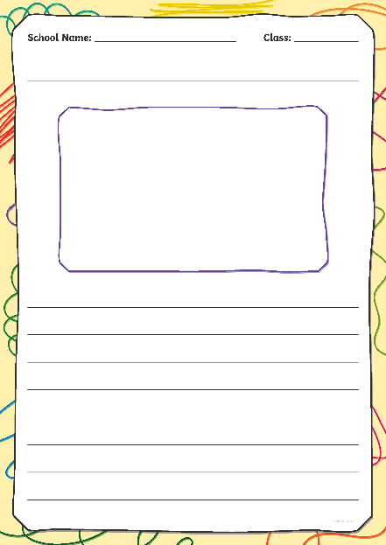
Michael Rosen’s Poetry Competition
Now that you have learnt all of Michael’s top tips,
it’s over to you to begin writing your own poem.
You may wish to use the Poetry Journal to record
your ideas and plan your poem.
When you’re happy with your poem,
use the Writing Frame to write it out neatly
before adding your own illustration.
Michael and his team can’t wait to read your poems. Good luck!

Slide 11
Illustrations © 2021 Tony Ross

